Slide 1



Learning to Play Magic Game Using Actor-Critic with Eligibility Trace
Amin Majdi

Slide 2
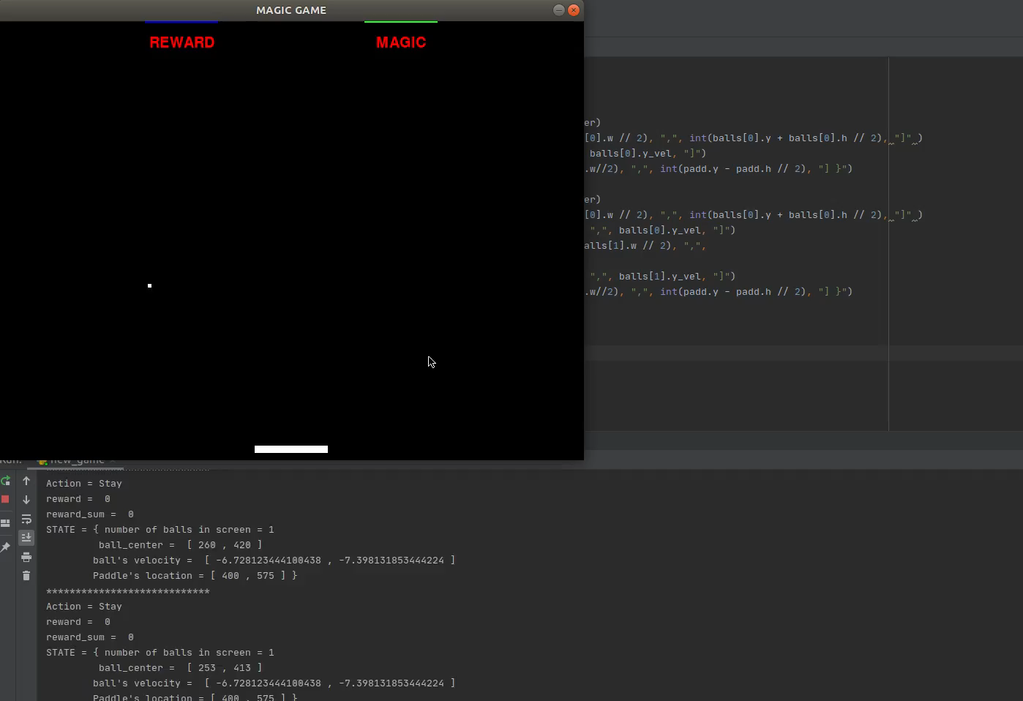
Magic Game
Simple version
One reward button
Advance Version
Reward button and Magic Button

Slide 3
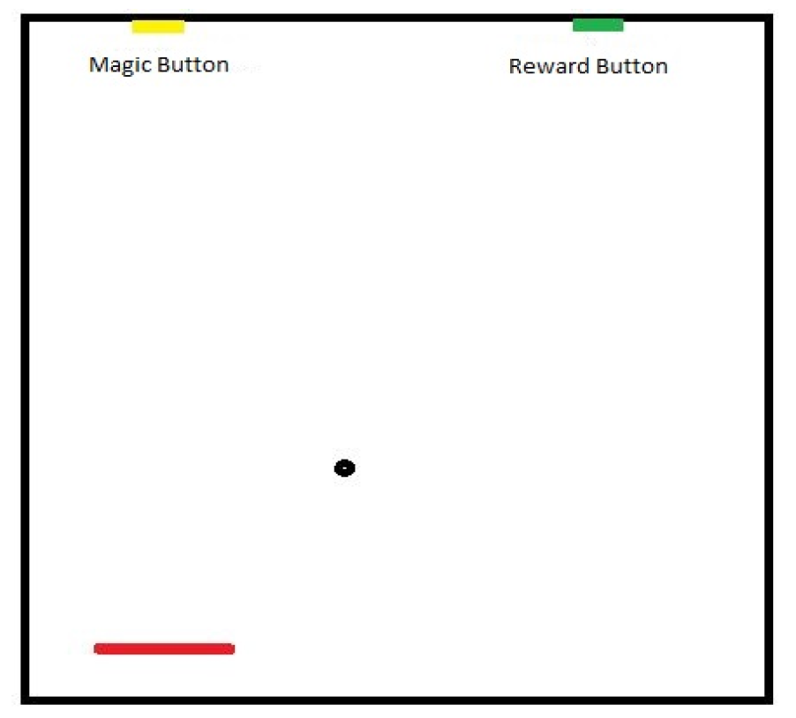
States, Actions, Rewards
y
Each step | -|X_p – X_b|
Missing the paddle | -1000
Hitting the paddle | 1000
Hitting reward button | 10000
θ
(x, y)
(x, .)
x

Slide 4
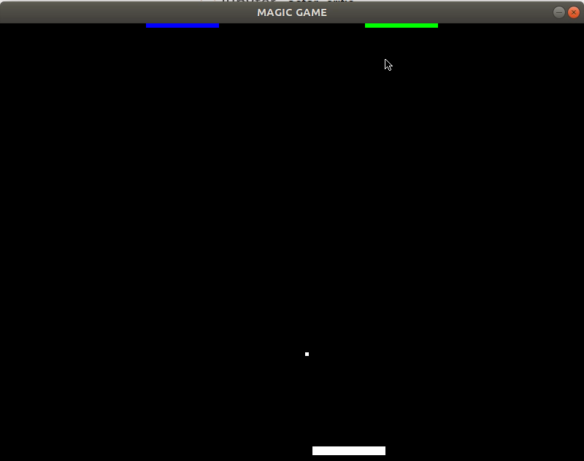
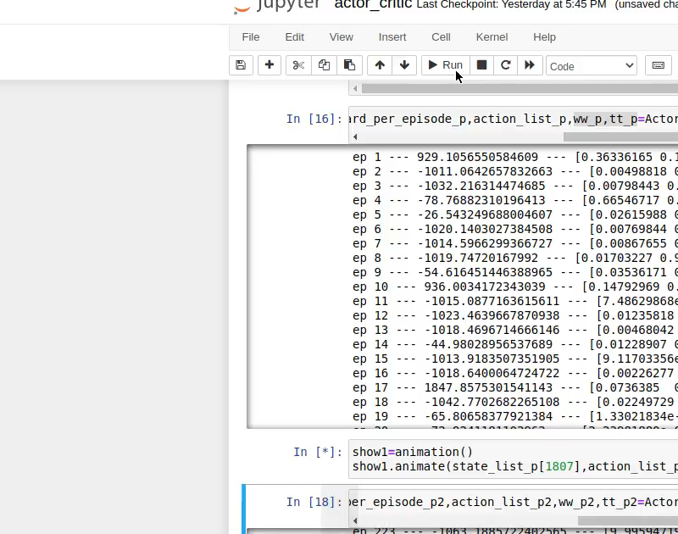
Results for Simplified version of the game using Actor Critic with eligibility Trace
Simplified version One
Simplified version Two

